Slide 1

BLUETOOTH CONTROLLED ORIGAMI SNAKE ROBOT
Prepared by-
Abhaya Shahare(2017PEB5095)
Under the guidance of-
Rakesh Bairathi

Slide 2
Contents:
Introduction
Framework of the robot
Flow Chart Of Project Conceptualization
Components Used
Arduino IDE
Bluetooth Controller
I2C Interface
Model tuning
Working
Results
Applications and future work
References

Slide 3
Introduction:
Soft robotics is an evolving branch of robotics and automation, invented in 2012 by George Whitesides, a chemistry professor in Harward University, USA. This stream of robotics emerged as an alternative to those frameworks of the robots where the rigidity is a major constraint.
Soft robotics draws heavily from the way in which living organisms move and adapt to their surroundings.
Robots that replicate the living organisms like snakes, spiders and worms have been attempted previously forming an array of multiple small rigid links so as to make it appear and function like a real organism.
Soft robots are best suited for the applications which involve the obstacle detection, and various aspects of search and rescue operations.
The aim is to fabricate a low cost, compact, Bluetooth controlled soft robotic snake which can perform locomotion with a regular serpentine gait in different directions, all controlled with the help of a mobile application ; and using the robot for obstacle detection. .

Slide 4
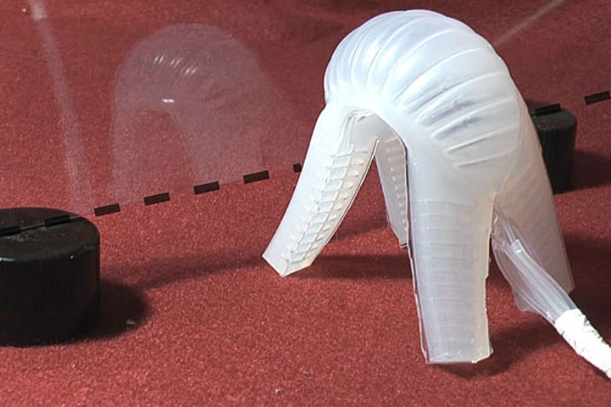
First crawling soft robot made by George Whitesides in 2012.

Slide 5
Framework Of The Robot :
Three independent continuum modules to are connected to each other to form one complete structure.
The outer body of the robot is made of transparent PET Sheets, where the structure is designed using yashimura origami crease pattern. The PET sheet is fixed between the PCB and the acrylic sheet which together makes one whole module.
Each module comprises of an Arduino NANO board as a main controller unit.
The data communication in between the modules is accomplished using I2C protocol; the head being the master and the mid and the tail being the slaves.
Each module has a servo motor with a long shaft mounted on the inner side of the PCB, the ends of the shaft are connected to the acrylic sheet with the help of nylon strings.
When the shaft has angular motion , the strings are pulled and released which in return generates the expansion and contraction of the module .
When all the three modules perform this motion at different timings, the overall result of the gait appears like a serpentine motion.
The aim is to fabricate a low cost, compact, Bluetooth controlled two-wheeled self-balancing robot with PID controller which can balance itself with utmost precision and responsiveness; and using to robot to practically analyze the responses and stability of the system for different control gain parameters.

Slide 6
The robot moves in a regular serpentine motion , unless it is obstructed by a hurdle.
The presence of a hurdle is detected by the IR sensors that are mounted on the face of the master module.
The obstacle, when detected, the master takes priority turn left and instructs slaves to the same. When obstacle is passed, resumes regular gait. If reaches dead end to the left, it takes turn to the right hand side and follows the same routine.
Entire robot is activated using a mobile bluetooth application. This application connects the mobile phone or laptop with the robot with the help of the bluetooth device mounted on the master module.
Along with activation and termination, left turn and right turn instructions also can be manually given to the robot with the help of this application.

Slide 7
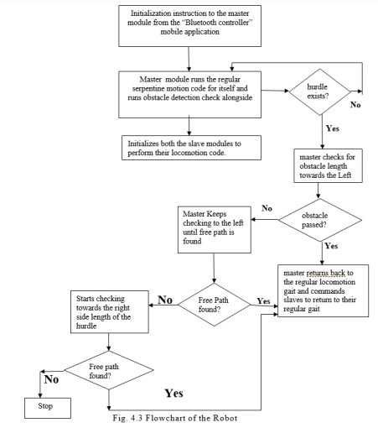
Flow Chart Of Project Conceptualization:

Slide 8
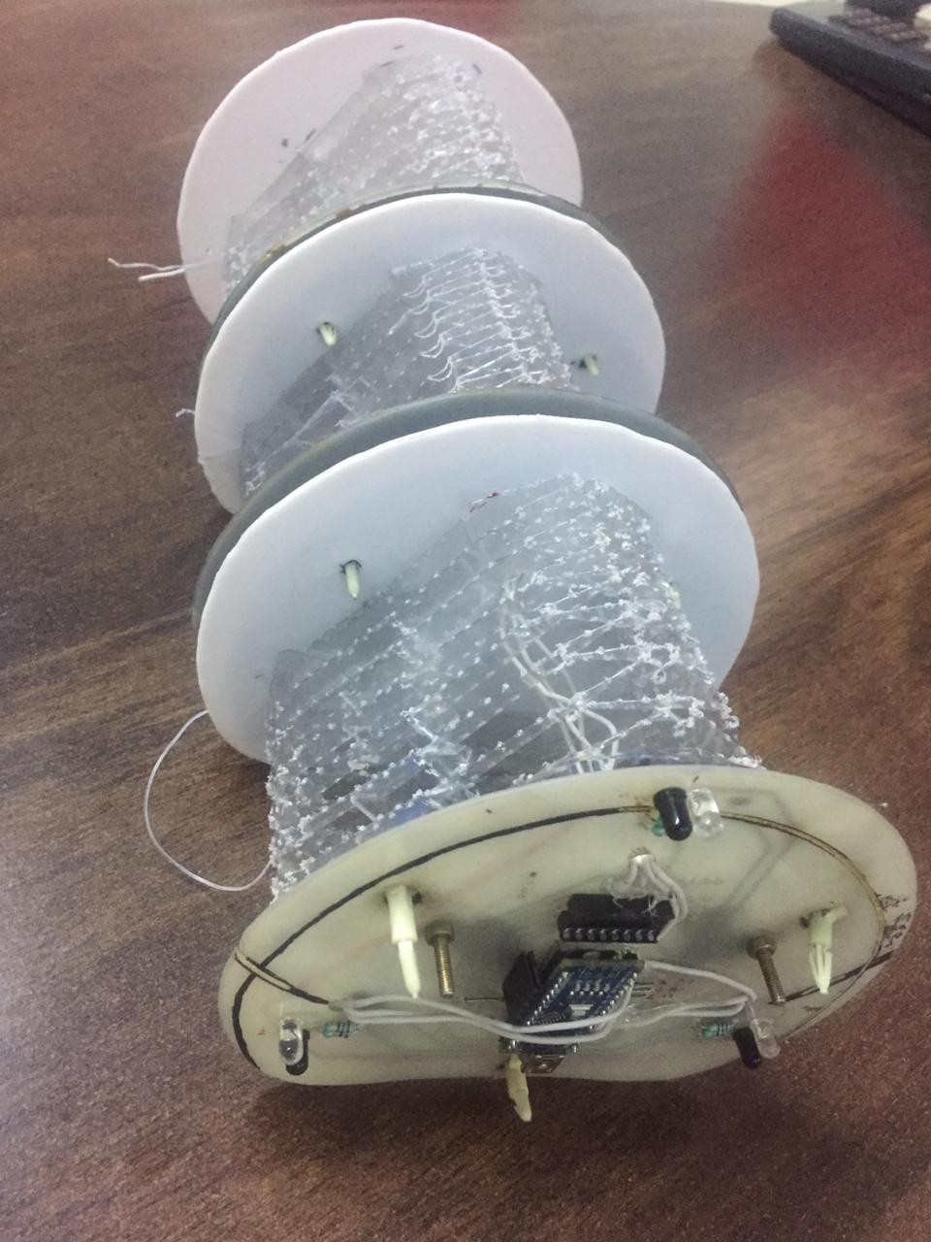
Bluetooth controlled origami snake robot

Slide 9
Hardware Components And Other Materials Used:
Arduino NANO
Servo Motor (MG996R)
IR Sensor (MPU6050)
Bluetooth device (HC05)
PET Sheets
Voltage Regulator IC (7805)
Lithium Ion battery
Master Slave PCB
Nylon strings
Acrylic Sheets

Slide 10
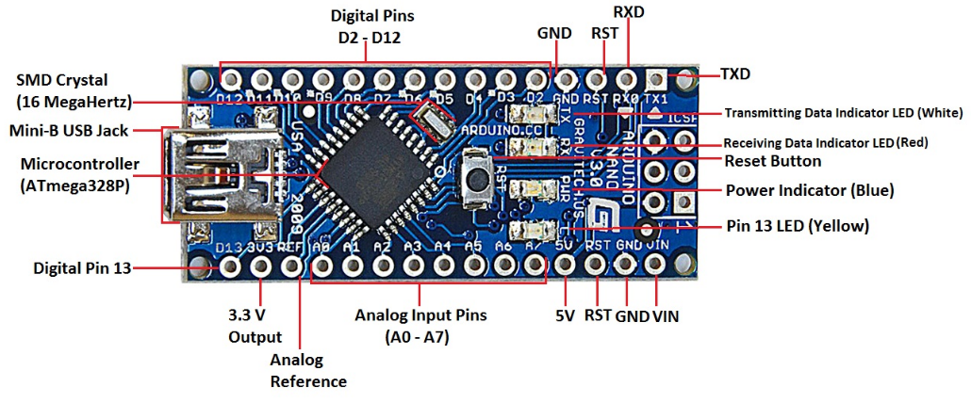
1. Arduino NANO:
Arduino board comes with a complete package which includes 5V regulator, an oscillator, a microcontroller, serial communication interface, LED, a burner and headers for the connection, which makes it very easy in use and very simple to assemble components with it. It is an open source prototyping platform. Its functionality is similar as the Arduino UNO but in different package. It uses mini USB for power supply and code uploading. It has no power plug for external power supply. The Arduino NANO is mainly based on AVR microcontroller Atmega328P and it comes with 6 analog input pins, USB interface and 14 I/O digital ports out of which 6 pins can be used for PWM output.

Slide 11
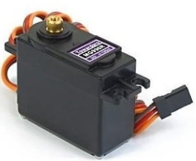
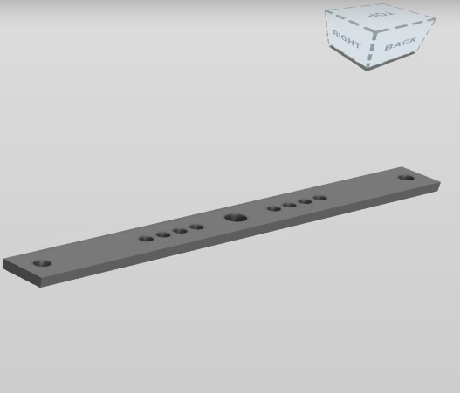
2. Servo motor (MG996R):
MG996R is a metal gear serfvo motor ith maximum stall torque of 11kg/cm. Like other RC servos(radio control), the motor rotates from 0 to 180 degrees based on duty cycle of PWM wave signal applied to this signal pin. The wiring of the motor goes as follows:
Red Wire- DC power supply (+5V)
Brown Wire- GND
Orange Wire-PWM input
The original shaft of the motor is 3.5 cm , this shaft is inefficient for the contraction- expansion mechanism that is required for a module, hence another shaft is designed using solidworks software that is of 6.6 cm in length and 5mm in width.
servo motor custom made shaft

Slide 12
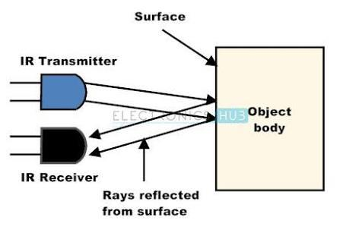
3. IR sensor:
IR sensor is a passive transmitter-receiver device that is used to detect objects in it’s radar. The IR transmitter transmits an infrared light signal. This signal when strikes with an object in it’s radar, bounces back in multiple directions including the direction in which the IR receiver exists. In this project, the IR sensor is used to detect obstacles that might come in front of the robot. Three IR sensors are placed on the head module one in each corner in order to detect the obstacles that will come in front of the robot.

Slide 13
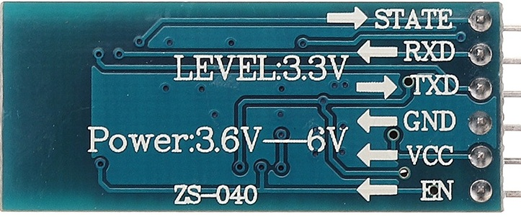
4. Bluetooth device (HC05):
Bluetooth module is used for wireless communication for sending and receiving data in the form of radio waves. Bluetooth has many advantages over other wireless communications like Wi-Fi. It has low power consumption and has better range than infrared communication. It is cheaper and data communication is much secure. HC05 is a bluetooth module which can be used as transmitter or receiver depending on master or slave configuration. It uses serial port (USART) for serial wireless communication with the Arduino. The role of the module i.e. master or slave can be configured by using AT commands. It has a red LED for indicating its connection status, whether it is connected or not.

Slide 14
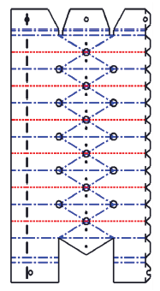
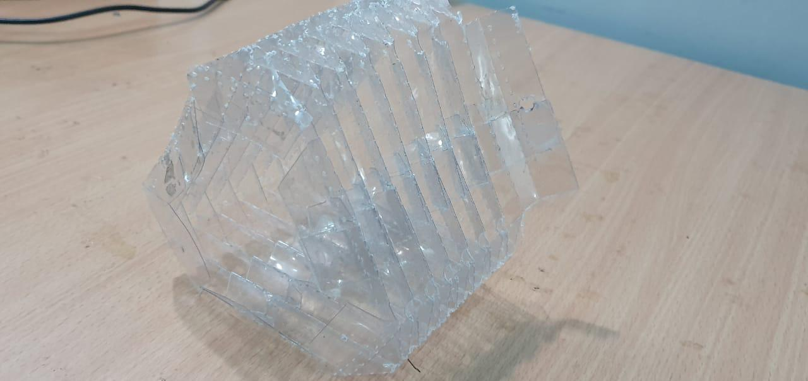
5. PET Sheets
PET stands for polyethylene Terephthalate . It is a synthetic resin made by copolymerizing ethylene glycol and terephthalic acid, widely used to make polyester fibres. Use of PET sheets for making soft robots has been taken into consideration for the material strength is high and provides enough flexibilty. The sheet used for this robot has a thickness of 178 microns. This thickness is enough to withhold the properties of flexibility of a snake. A 2D planar sheet is laser cut based on a CDR file that contains the yashimura design pattern which is later folded into a 3D model that would make the outer body of the robot.

Slide 15
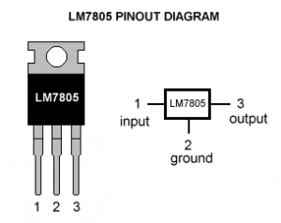
6. Voltage Regulator IC 7805:
IC 7805 is used to generate 5V power supply for the motor driver IC. It is connected to the 5V pin of Arduino NANO and to the VCC pins of the L293D. IC 7805 is used here to generate the required 5V output voltage for the components to work smoothly. This voltage regulator IC is a small 3 pin IC and is essential in this case for it is fixed under the NANO board and that is a space saver.

Slide 16
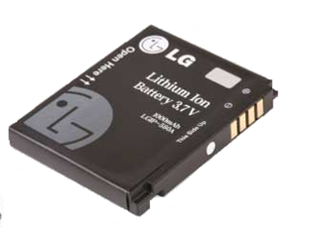
7. Lithium Ion Battery:
Li-ion is a low-maintenance rechargable battery, an advantage that most other chemistries cannot claim. The battery has no memory and does not need exercising (deliberate full discharge) to keep it in good shape. Self-discharge is less than half that of nickel-based systems and this helps the fuel gauge applications. The nominal cell voltage of 3.60V can directly power mobile phones, tablets and digital cameras, offering simplifications and cost reductions over multi-cell designs. Three batteries are connected in series to generate an overall 9V for this robot .

Slide 17
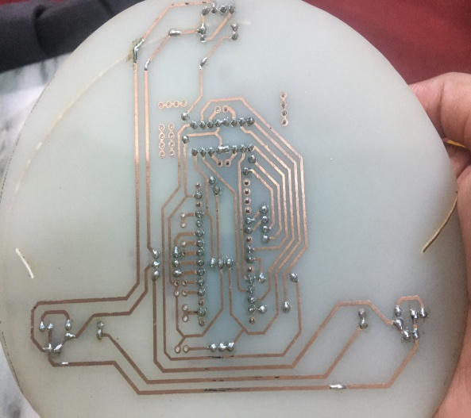
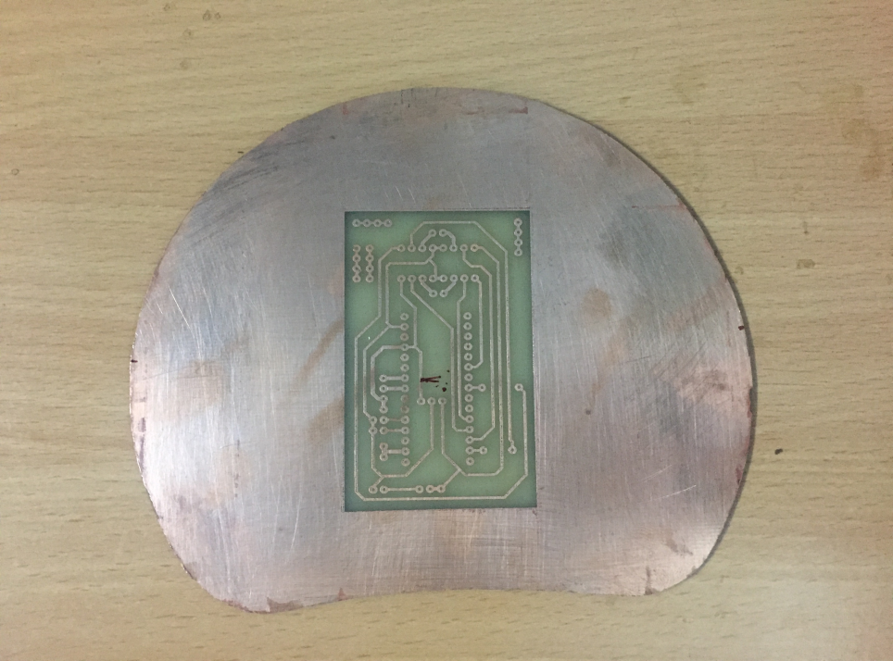
8. Master And Slave PCB:
The master PCB is designed so as to control a servo motor mounted on it along with activating and instructing two slave modules . The master PCB also has the circuitry for object detection , three IR sensors have been mounted on the master , one placed in each corner. The slave PCB design is same as the master saving it for object detection circuit. The dimensions of the PCB are 12 x 14.4 cm (H x W).
master PCB layout slave PCB layout

Slide 18
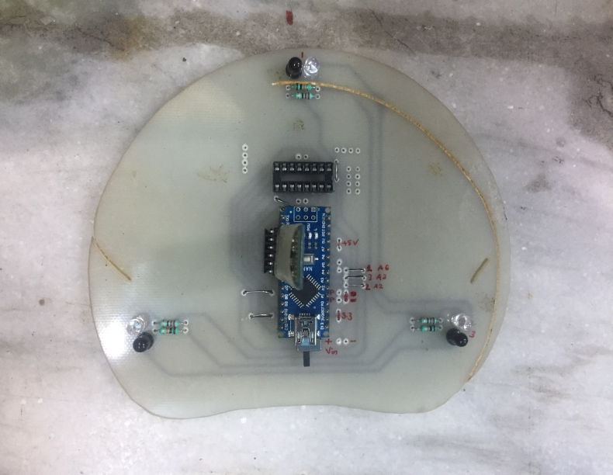
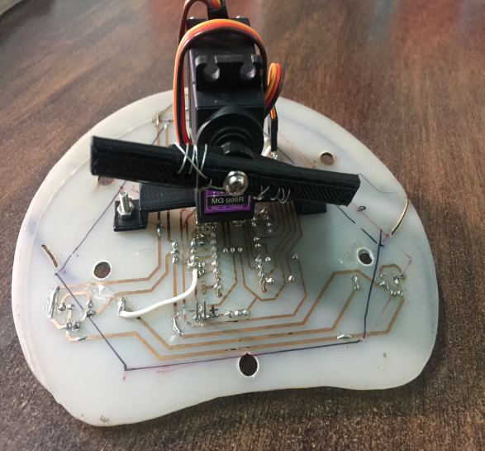
The placement of the servo motors on the PCB is done by mounting them on the inner side of the module with the help of a custom designed plastic base. The master PCB after mounting the hardware appears as shown below:
Front end of the master PCB Servo motor mounting on PCB

Slide 19
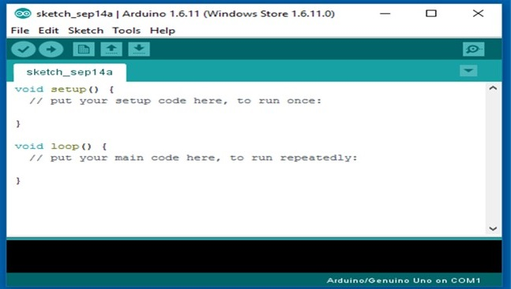
Arduino IDE:
Arduino IDE (Integrated Development Environment) is an official Arduino software which is mainly used for writing, compiling and uploading the sketch or code into the Arduino modules. It is an open source software. It runs on the Java platform which comes with many inbuilt commands and functions that play an important role in editing, compiling and debugging the code in the environment. The IDE mainly consists of two basic parts: Editor which is used for writing the required code and Compiler which is used for compiling and uploading the sketch into the given Arduino device. The coding for this project has been done in C.

Slide 20
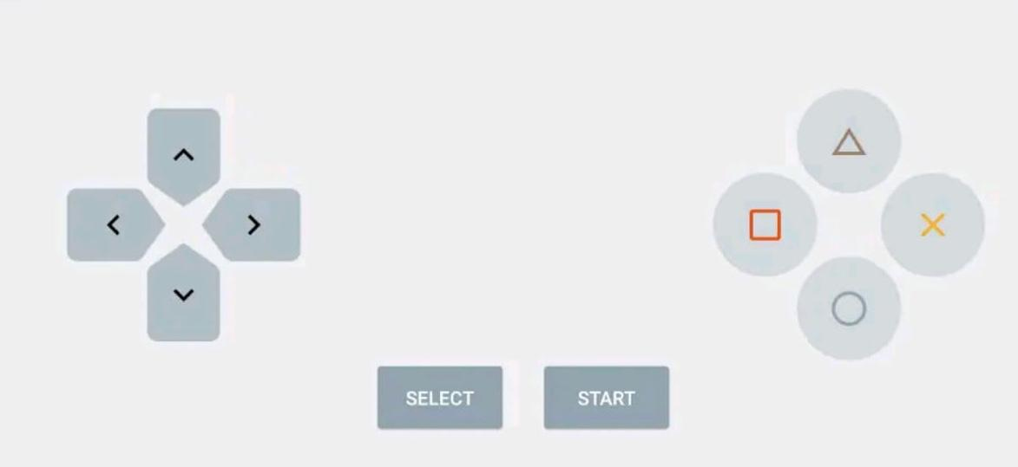
Bluetooth Controller:
The Bluetooth controller mobile application is used as a remote control for controlling the motion of the robot. The application supports the android version 4.0.4 and onwards.
The Bluetooth application has pre-set tools that look like the buttons of a remote control viz. up-arrow , down-arrow, left-arrow, right-arrow, start, stop and pause buttons.
The Bluetooth device that is placed on the robot is paired with the mobile phone application in order to make the robot accessible to the application.
The Bluetooth device that is placed on the robot is connected to the arduino NANO and the microcontroller is coded so as to allow the mobile application monitor the robot.
Any bluetooth controller application can be used for this purpose; an application that can be handled either from an android mobile phone or a laptop .
The control panel of the bluetooth controller mobile application

Slide 21
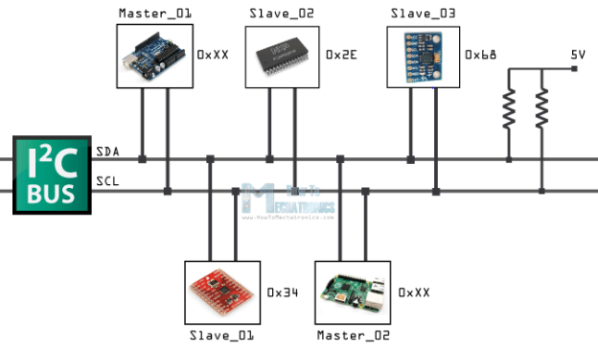
I2C interface:
I2C (Inter Integrated Circuit) is a two-wired serial interface which is used to connect low speed sensors or devices like microcontroller, ADC, DAC, EEPROMs and other ICs for intra-board, short distance communication. It is synchronous, multi-slave, multi-master, packet switched, simple and easy to use interface. In I2C communication, master device doesn’t need any address since it generates clock via SCL and addresses various individual I2C slave devices. Each I2C slave device has a 7-bit address which must need to be unique in the interface (bus).
I2C Protocol

Slide 22
Model Tuning:
The Bluetooth device on the robot is paired with the Bluetooth of the android mobile phone. The Bluetooth module on the robot is configured with respect to the Bluetooth controller application, the controls of the robot from the application are coded in the Arduino code.
The ‘start ’ command is given to the robot from the mobile phone application . On
Initialization , The robot is expected to start the gait and then as per the hurdles in the
way, it is expected to change it’s direction of locomotion.
The IR sensors are placed on the head(master) module with the help of which the obstacles will be detected.
The servo motor’s shaft is a rest i.e. 0 degrees deflection. The I2C communication is established between one master and two slave modules.
I2C communication is the main element responsible for the overall data communication between the master and the slaves. A4, A5 and GND pins of all the Arduino NANOs are connected over one bus for data transfer. The power supply is given via the lithium ion batteries placed at the tail end. Three such batteries with value 3.7V are series connected to to give overall 9V.

Slide 23
Working:
The android mobile application named “Bluetooth controller” is used to initialize the robot.
The master module starts initialization of itself and the slave modules
The servo motors take 45 degree angle turns towards left and right alternately.
The motion of the master starts first, succeeded by the tail module and lastly moves.
The master module is continuously checking for the obstacles or hurdles with the help of the IR sensors mounted on it.
If the master module is detecting an obstacle, the module checks free path towards the left of the hurdle.
Keeps checking until a free path is found. The master bends in that direction accordingly. The master also sends the instructions to slave modules to change gait accordingly.

Slide 24
Working:
If free path is found, master resumes to the regular locomotion and commands the same to the two slave modules.
If no free path is found to the left, the master starts checking the free path to the right of the obstacle.
If free path is found, master returns back to the regular locomotion and notifies the slaves modules to do the same.
If no free path is found in either of the directions, the master module aborts the motion and commands the slaves to do the same.

Slide 25
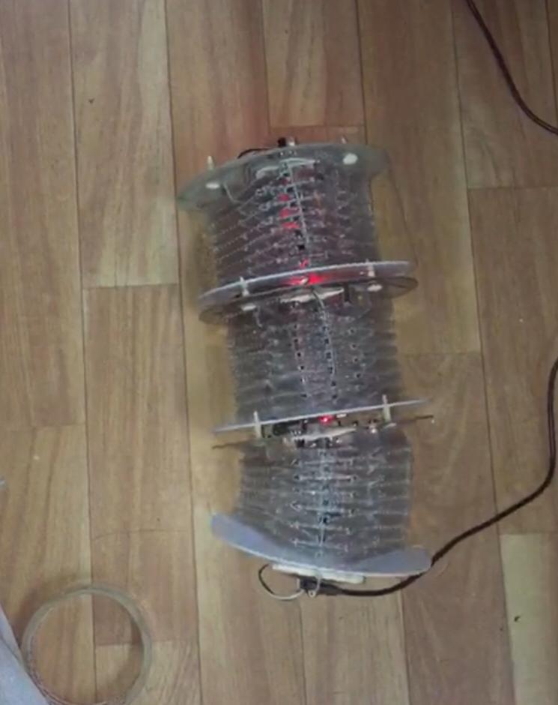
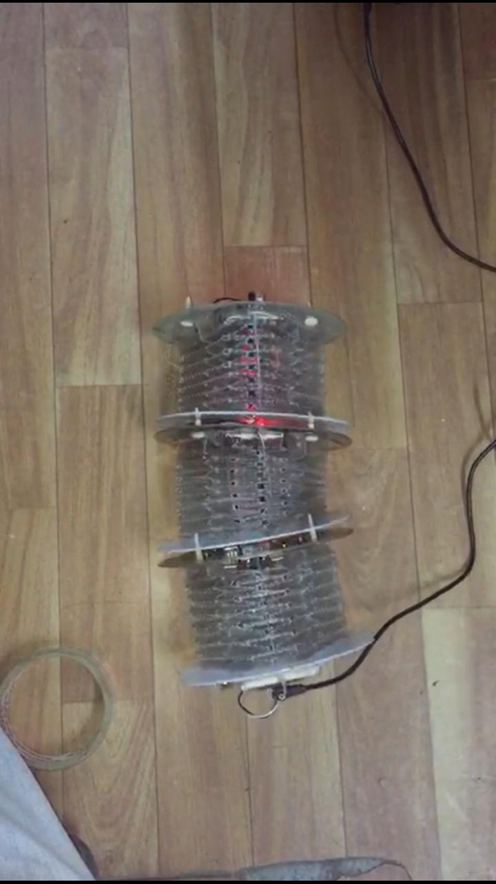
Position of robot at 2 sec
Position of robot at 2.75 sec

Slide 26
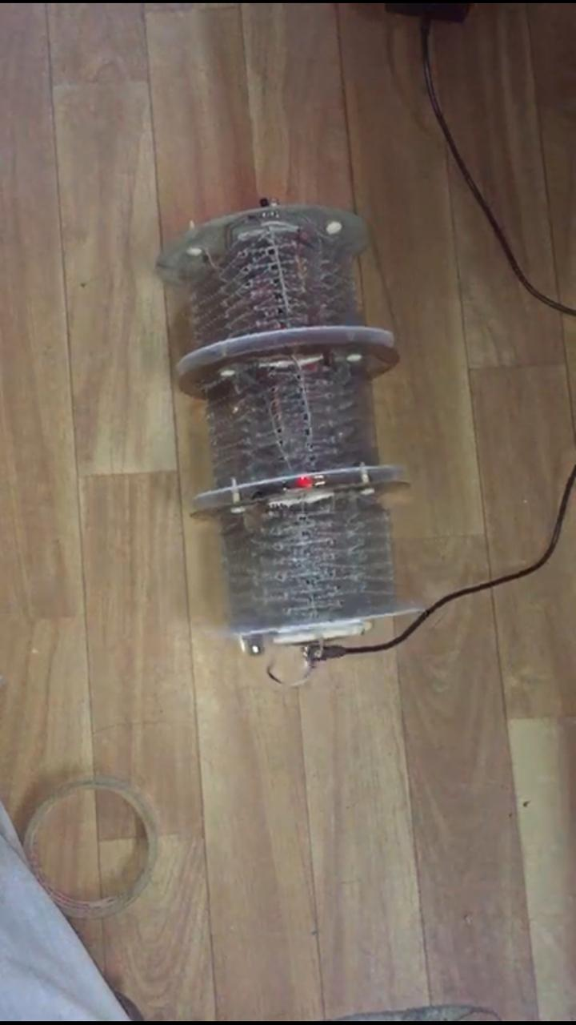
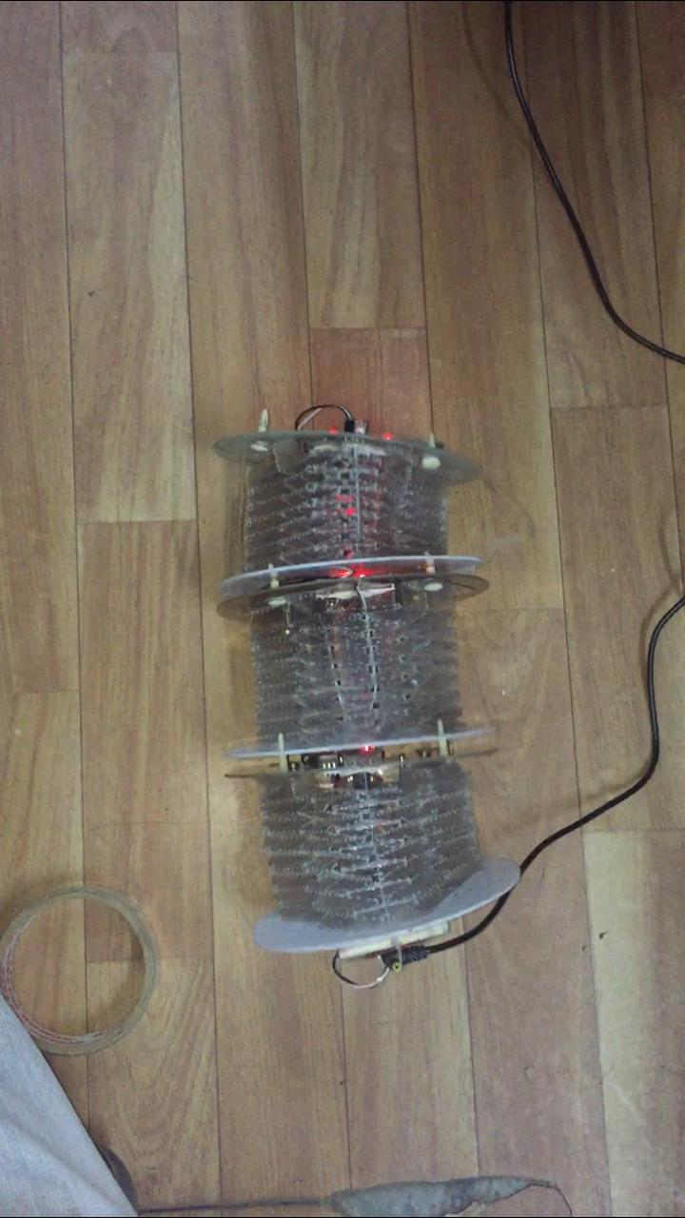
Position of robot at 3 sec
Position of robot at 3.5 sec

Slide 27
Results:
The module height is 8 cm when in reset mode.
The master module and slave modules together make the snake robot 24 cm long.
The servo motors deflect from origin with an angle of 45 degree to the left and the right alternatively.
The master moves first, then the tail and lastly the mid module.
The entire robot moves with a speed of 6mm/s.
The maximum compression occurring on each side of the module is in between 60 degree to 75 degrees.
When an obstacle is detected the maximum compression occurred in the module is upto 40 degrees
When a hurdle comes, the master module deflects more towards left and subsequently the slave modules too.
When free path is found, the master module returns to the regular gait and also commands the slaves to do the same.
When no free path found on the left side, the module moves towards the right side.
When free path found on the right, the module starts moving on that free path by returning to the original gait.

Slide 28
Applications and Future work:
This robot is able to perform obstacle detection.
The robot can move in forward, left , right directions as instructed by the mobile application.
By making it wifi module and camera enabled, this robot could be sent in places where it is humanly impossible to reach or fit in.
The robot can be equipped with other functionalities like detecting human bodies or animals by fixing heat sensors on it.
The master module can be programmed in such a way that when it checks for obstacles or objects, it can measure the width of them by simultaneously scanning the object length on both the sides.
When the hardware selected is so that the overall size of the robot reduces, along with making the outer body a compact and waterproof structure, this robot can be used to move in the sewage pipes and underground mining.
The robot can be used in search an rescue operations.

Slide 29
References:
Ming Luo, Ruibo Yan , Zhenyu Wan, Yun kin, Erik H. Skorina, Cagdas D. Onal, “Orisnake: Design, Fabrication and Experimental Analysis of a 3-D Origami Snake Robot” IEEE Robotics and Automation Letters, Vol.3, No.3, July 2018
J Santoso, E. Skorin, M.Luo, R. Yan and C.D Onal, “Design and analysis of an origami continuum manipulation module with torsional strength ,”in Proc.IEEE/RSJ Int. Conf. Intell. Robots Syst.,2017,pp.2098-2104
Alessandro Fairnelli; Giorgio Grisetti And Luca Locci,“Design and Implementation of Modular software for programming mobile robots” International journal of Advanced Robotic Systems, Vol.3, No.1(2006)
Cornell Wright, Austin Buchan, Ben Brown, Jason Geist, Michael Schwerin,” Design and architecture of modular snake robot” Conf. IEEE International Conference on Robotics And Automation, 2007,pp.2609-2614

Slide 30
K.L. Paap, T. Christaller, F. Kirchner,” A robot snake to inspect broken buildings”, Proceedings of the 2000 IEEE/RSJ, International Conference on Intelligent Robots and Systems
Ketao Zhang, Chen Qiu, Jian S Dai, “An extensible continuum robot with integrated origami parallel modules”,Journal of Mechanics and Robotics, JMR-15-1175
Ming Luo, Wut Yee Oo, Fuchen Chen, C. D. Onal, Erik. H. Skorina,” Reverse pneumatic artificial muscles, modeling, integration and control”, https://doi.org/10.1371/journal.pone.0204637
Evgueni T.Filipov, Tomohiro Tachi, and Glaucio H. Paulino,”Origami tubes assembled into stiff, yet reconfigurable structures and metamaterials”, www.pnas.org/cgi/doi/10.1073/pnas.1509465112

Slide 31
Thank You

